Slide 1

Random Password Generator NAME : YAMINI TOPIC : Random Password Generator

Slide 2

INTRODUCTION
A Random Password Generator helps solve this problem by creating strong, unique passwords that are difficult to guess or crack.
This presentation will explore what random password generators are, why strong passwords matter, and how you can generate secure passwords easily.

Slide 3

OBJECTIVES OF THE PROJECT
To develop a tool that generates strong, random passwords
To enhance online security by reducing reliance on weak or reused passwords
To provide customizable options like password length and character types
To demonstrate a simple programmatic approach to password generation
To raise awareness about the importance of using secure passwords in everyday life

Slide 4

What Password Generator
A Random Password Generator is a tool or software application that automatically creates strong, unpredictable passwords
passwords using a combination of :
Uppercase and lowercase letters
Numbers
Special characters(e.g., @, #, $, &)

Slide 5
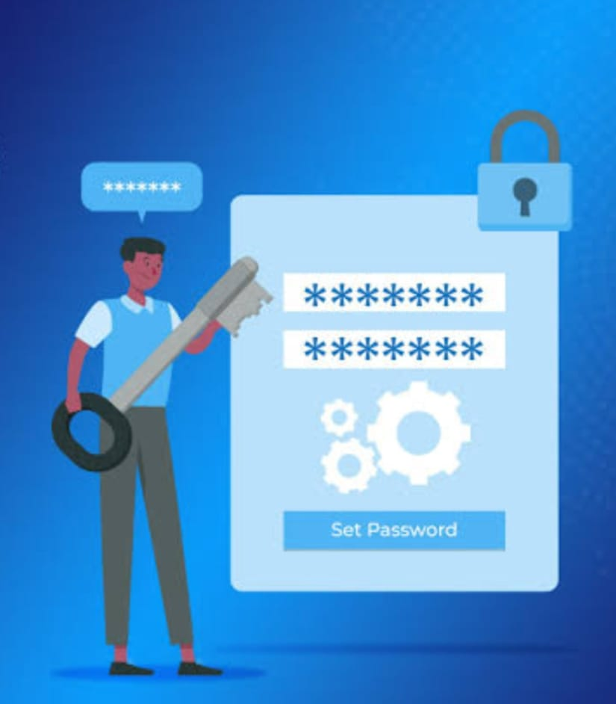
Why Do You Create Passwords?
Passwords are created to protect access to our personal, professional, and financial information stored in:
Email accounts
Social media platforms
Online banking
Work systems
Apps and devices

Slide 6
KEY FEATURES
Custom Length Selection
Character Type Inclusion
One-Click Generation
Copy to Clipboard
Strong Randomization
User-Friendly Interface
Mobile & Desktop Compatibility
Password Strength Indicator

Slide 7
TYPES OF PASSWORD GENERATOR
Random Character Generators
Mnemonic or Passphrase Generators
Pattern-Based Generators
Dictionary-Based Generators
Deterministic Generators (Password Managers)
AI-Enhanced Generators

Slide 8
ADVANTAGES
Creates strong, unpredictable passwords that are hard to crack.
Instantly generates passwords without needing to think of one manually.
Encourages unique passwords for each account, reducing vulnerability.
Allows control over password length, use of symbols, numbers, etc.
Eliminates common patterns, weak words, and guessable formats.

Slide 9
DISADVANTAGES
Random passwords are often complex and difficult to memorize.
Users may rely too heavily on generators or password managers.
Secure storage (e.g., a password manager) is needed to keep track of generated passwords.
If passwords are copied/stored insecurely, even strong ones can be compromised.
Generators don’t protect against phishing or keylogging attacks.

Slide 10

CONCLUSION
Strong passwords are essential for protecting digital identities and sensitive data.
A Random Password Generator helps create secure, unique passwords that are difficult to guess or crack.
Implementing strong passwords is a crucial step toward better cybersecurity in personal and professional life.

Slide 11


